Slide 1
Unit - 6
String Matching and NP- completeness

Slide 2
Outline
Naïve String Matching Algorithm
Rabin Karp Algorithm
String Matching with Finite Automata
KMP Algorithm
The Class P and NP, Polynomial reduction, NP-Completeness problem, NP-Hard Problems

Slide 3
Introduction:
Pattern searching is an important problem in computer science. When we do search for a string in notepad/word file or browser or database, pattern searching algorithms are used to show the search results.
The algorithms are tries to find one or many indices where one or several strings or pattern are found in the larger string or text.
String matching is used in various applications like
spell checkers, spam filters, search engines, plagiarism detectors, bioinformatics and DNA sequencing etc.

Slide 4
Algorithms used for string matching
The Naive String Matching Algorithm
The Rabin-Karp Algorithm
String Matching with Finite Automata
The Knuth-Morris Pratt Algorithm

Slide 5
Applications:
Plagiarism Detection
Bioinformatic and DNA Sequencing
Digital Forensic
Spelling Checker
Spam Filter
Search engine or content search in large database

Slide 6
Naïve String Matching Algorithm:
Naive string matching algorithm compare the first element of the pattern to be searched 'p' with the first element of the string 's' in which to locate 'p'.
If the first element of 'p' matches the first element of 's', compare the second element and so on. If match found proceed likewise until entire 'p' is found.
If a mismatch is found at any position, shift index to one position to the right and continue comparison.
This approach is easy to understand and implement but it can be too slow in some case. In worst case it may take (m*n) iterations to complete the task.

Slide 7
What is the best case? The best case occurs when the first character of the pattern is not present in text at all. The number of comparisons in best case is O(n).
Example: text[] = "AABCCAADDEE“, pattern[] = "FAA";
What is the worst case ? The worst case of Naive Pattern Searching occurs in following scenarios. 1) When all characters of the text and pattern are same.
Example: text[] = "AAAAAAAAAAAAAAAAAA“, pattern[] = "AAAAA";
2) Worst case also occurs when only the last character is different.
Example: text[] = "AAAAAAAAAAAAAAAAAB“, pattern[] = "AAAAB";

Slide 8
The number of comparisons in the worst case is O(m*(n-m+1)).
Although strings which have repeated characters are not likely to appear in English text, they may well occur in other applications (for example, in binary texts).
The KMP matching algorithm improves the worst case to O(n).

Slide 9
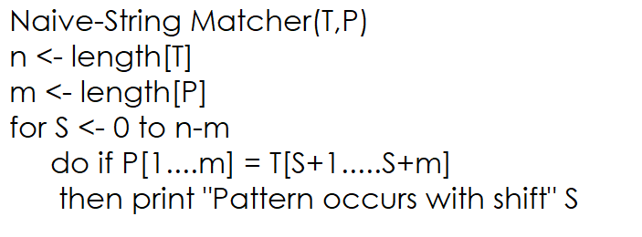
Algorithm:

Slide 10
The Rabin – Karp Algorithm:
Rabin-Karp algorithm is an algorithm used for searching/matching patterns in the text using a hash function.
Unlike Naive string matching algorithm, it does not travel through every character in the initial phase rather it filters the characters that do not match and then performs the comparison.
A hash function is a tool to map a larger input value to a smaller output value and output value is called as hash value.
The Rabin-Karp string matching algorithm calculates a hash value for the pattern as well as for each M-character subsequences of text to be compared. If the hash values are unequal, the algorithm will determine the hash value for next M-character sequence.
If the hash values are equal, the algorithm will analyze the pattern and the M-character sequence.

Slide 11
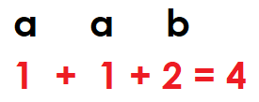
In this method, Instead of checking each and every alphabets make a single value of them. So for conversion, numeric value as well as ASCII values are used.
So, taking smaller values for understanding: a=1, b=2, c=3, d=4, e=5, f=6, g=7, h=8, i=9, j=10.
Example: Text=“aaaaab”, pattern=“aab”
Pattern:
Hash-code value

Slide 12
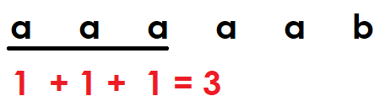

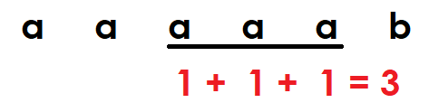
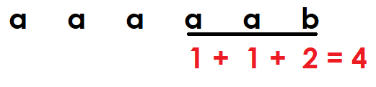
Text:
Once the hash-code value is matched than compare each character of pattern with each character of text. If it is matched means pattern is there in the text.
Here ,sliding from one set of characters to other set of character is known as sliding/rolling hash function.

Slide 13
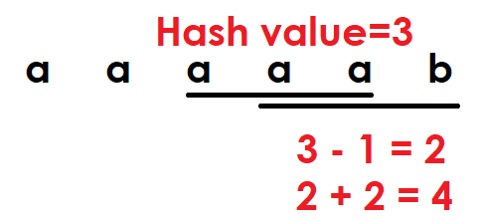
Calculation of Rolling Hash function:
To easily get the hash value of next set of character, just subtract the value of ‘a’ and add the value of ‘b’.

Slide 14
Drawback of Rabin Karp Algorithm:
there are many hash code values of pattern that are matching with text but those are not the patterns are known as spurious hit.
In such situation maximum time taken by the algorithm is Ɵ(mn).
The spurious hit is encountered because selection of hash function is very simple. Use some strong hash function to avoid the spurious hit.

Slide 15
The idea given by Rabin karp is
He introduce the idea of hash function and this function is called rolling hash function as well as they have given the base power we should take and it is known as rabin fingerprint function.
so there is no spurious hit and the time taken by the algorithm is Ɵ(n-m+1) in average case but still there may be possibility that there is a spurious hit.
So the worst case time complexity of the algorithm is still Ɵ(mn). so, using this hash function reduce the chance of worst case.

Slide 16
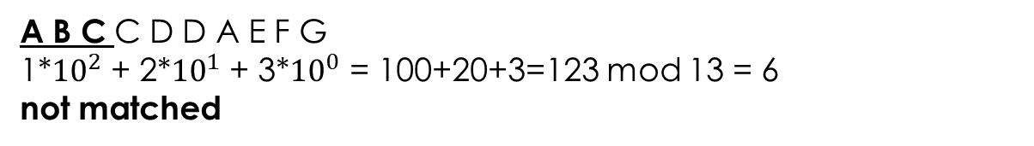
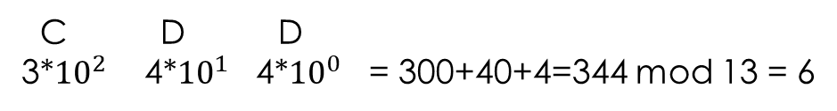
Example:
Text: A B C C D D A E F G
Pattern: C D D
Pattern:
C D D
3*${10}^{2}$ 4*${10}^{1}$ 4*${10}^{0}$ = 300+40+4=344 mod 13 = 6
Check Pattern in the text
A B C C D D A E F G
1*${10}^{2}$ + 2*${10}^{1}$ + 3*${10}^{0}$ = 100+20+3=123 mod 13 = 6
not matched

Slide 17
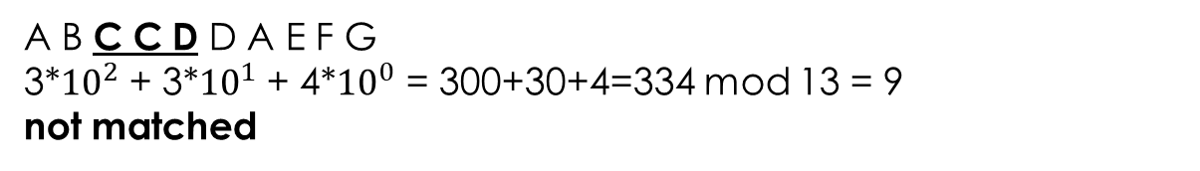
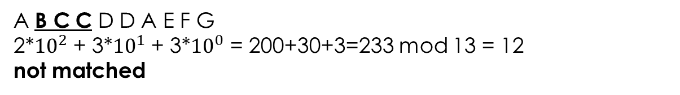
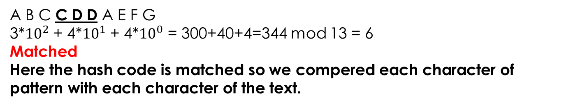
A B C C D D A E F G
2*${10}^{2}$ + 3*${10}^{1}$ + 3*${10}^{0}$ = 200+30+3=233 mod 13 = 12
not matched
A B C C D D A E F G
3*${10}^{2}$ + 3*${10}^{1}$ + 4*${10}^{0}$ = 300+30+4=334 mod 13 = 9
not matched
A B C C D D A E F G
3*${10}^{2}$ + 4*${10}^{1}$ + 4*${10}^{0}$ = 300+40+4=344 mod 13 = 6
Matched
Here the hash code is matched so we compered each character of pattern with each character of the text.

Slide 18
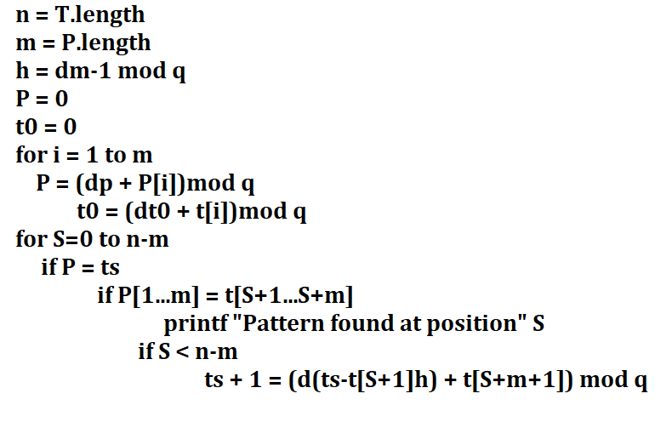
Algorithm:

Slide 19
Time Complexity:
Average case and Best case time complexity is O(m+n)
Worst case time complexity is O(mn) (Occurs when spurious hits occur a number for all the windows.)

Slide 20
Limitation:
Spurious Hit:
When the hash value of the pattern matches with the hash value of text but the window is not the actual pattern then it is called a spurious hit.
Spurious hit increases the time complexity of the algorithm. In order to minimize spurious hit, we use modulus which reduces the spurious hit.

Slide 21
Applications:
For pattern matching.
For searching string in a bigger text.

Slide 22
String Matching With Finite Automata:
The string matching automaton is very effective tool used in string matching algorithms. It examines each character in the text exactly once and reports all the valid shifts in O(n) time.
Construction of FA is the main part of this algorithm. Once the FA is built searching is simple.
In search, we simply need to start from the first state of the automata and the first character of the text. At every step, we consider next character of text look for the next state in the built of FA and move to a new state.

Slide 23
Finite Automata:
A finite automaton is of 5-tuple (Q, q₀,A,∑_{δ,} δ), where
Q is a finite set of states,
q₀ ∈ Q is the start state,
A ⊆ Q is a notable set of accepting states,
∑ is a finite input alphabet,
δ is a function from Q x ∑ into Q called the transition function of M.

Slide 24
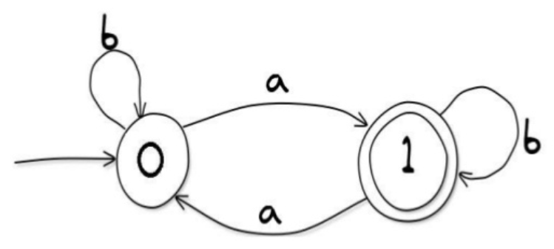
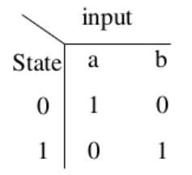
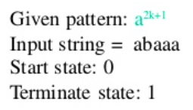
Finite Automata
Transition Table

Slide 25
The finite automaton starts in state q₀ and reads the characters of its input string one at a time. If the automaton is in state q and reads input character a, it moves from state q to state δ (q, a).
Whenever its current state q is a member of A, the machine M has accepted the string read so far. An input that is not allowed is rejected.

Slide 26
The basic idea is to build a automaton in which
Each character in the pattern has a state.
Each match sends the automaton into a new state.
If all the characters in the pattern has been matched, the automaton enters the accepting state.
Otherwise, the automaton will return to a suitable state according to the current state and the input character.
The matching takes O(n) time since each character is examined once.

Slide 27
Example:
Finite state of automation only accepts even number of a’s.
Set of valid alphabets ∑ = {a, b, c}
b, c
b, c
b, c
q₀
a
q₁
a
q₂
a
No a’s
Odd no
of a’s
Even no
of a’s

Slide 28
Transition Function:
a | b | c
q₁ | q₀ | q₀
q₂ | q₁ | q₁
q₁ | q₂ | q₂
q₀
q₁
q₂

Slide 29
Here we text is: b c a a b c a a a b a c
Here I have 6 number of a’s means technically I should end with q_{2.}
q₀
q₀
q₁
q₂
q₂
q₂
q₁
q₂
q₁
q₁
q₂
q₂
So, at the end of string q₂ becomes final state. q₂ is final state and
it is accepting state means the given string has even no. of a’s.

Slide 30
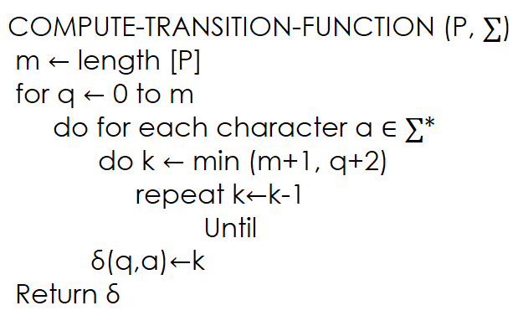
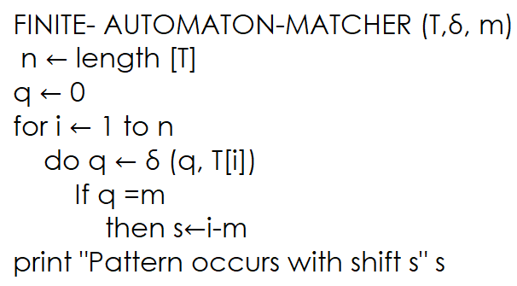
Algorithm:

Slide 31
Time Complexity: O(n)
If we ever reach to q₈ which is accepting state in that case we found the pattern otherwise we have not found the pattern.

Slide 32
The Knuth Morris Pratt Algorithm:
Given a string 'S', the problem of string matching deals with finding whether a pattern ‘P' occurs in 'S' and if ‘P' does occur then returning position in 'S' where ‘P' occurs.
if 'm' is the length of pattern ‘P' and 'n' is the length of string 'S‘ than the matching time is of the order O(mn).
What makes this approach so slow is the fact that elements of 'S' with which comparisons had been performed earlier are involved again and again in comparisons in some future iterations.
These repetitive comparisons which lead to the runtime of O(mn).

Slide 33
i
i
i
i
i
i
i
i
i
i
i
i
Text:
a b c d a b c a b c d f
1 2 3 4 5 6 7 8 9 10 11 12
When i and j is matched than shift their position at right side.
So characters in the string are compared repeatedly. When mismatch occurs than it is shifting i/backtrack i.
Drawback of Naïve string matching algorithm is, it doesn’t study the pattern and blindly checking every alphabet and shifting the pattern by 1 step in case of mismatch. So, maximum time taken by the algorithm is O(mn).
Pattern:
a b c d f
1 2 3 4 5
j
j
j
j
j
Mismatched

Slide 34
Knuth-Morris and Pratt introduce a linear time algorithm for the string matching problem.
A matching time of O(n) is achieved by avoiding comparison with an element of 'S' that have previously been involved in comparison with some element of the pattern ‘P' to be matched. i.e., backtracking on the string 'S' never occurs.
Components of KMP Algorithm:
The Prefix Function (Π): The Prefix Function Π for a pattern encapsulates knowledge about how the pattern matches against the shift of itself. This information can be used to avoid a useless shift of the pattern ‘P‘ which enables avoiding backtracking of the string 'S.‘
The KMP Matcher: With string 'S’, pattern ‘P’ and prefix function 'Π' as inputs, find the occurrence of ‘P' in 'S' and returns the number of shifts of ‘P' after which occurrences are found.

Slide 35
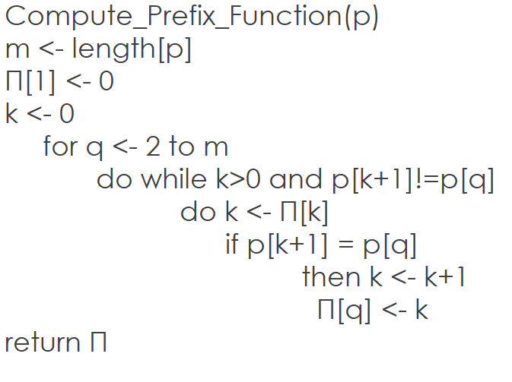
The Prefix Function π

Slide 36
Example: Compute π for the pattern ‘p’
P :
a b a b a c a
p
1
2
3
4
5
6
Step: 1
q
a
b
a
b
a
c
π
0
0
p
1
2
3
4
5
6
Step: 2
q
a
b
b
a
a
c
π
0
0
1

Slide 37
p
1
2
3
4
5
6
7
Step: 3
q
a
b
b
a
a
c
a
π
0
0
1
2
p
1
2
3
4
5
6
7
Step: 4
q
a
b
a
b
a
c
a
π
0
0
1
2
3
p
1
2
3
4
5
6
7
Step: 5
q
a
b
a
b
a
c
a
π
0
0
1
2
3
0

Slide 38
p
1
2
3
4
5
6
7
Step: 6
q
a
b
a
b
a
c
a
π
0
0
1
2
3
0
1
After iterating 6 times, the prefix function computation is complete.

Slide 39
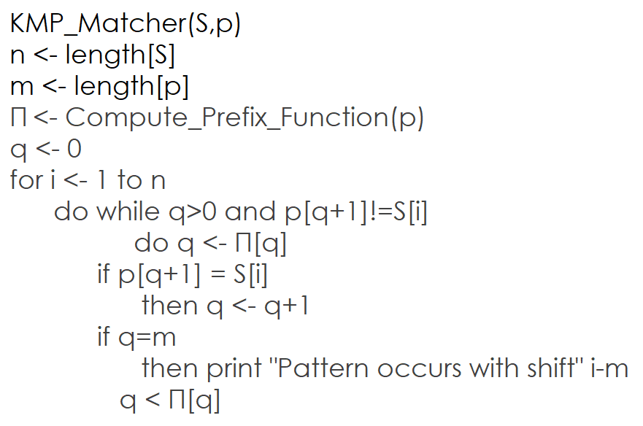
The KMP Matcher:

Slide 40
S:
a b a b c a b c a b a b a b d
p:
a b a b d
For ‘p’ the prefix function. Π was computed as follow:
p
1
2
3
4
5
q
a
b
a
b
d
π
0
0
1
2
0

Slide 41
i
i
i
i
i
i
i
i
i
i
i
i
i
i
i
i
S:
a b a b c a b c a b a b a b d
1
2
3
4
5
6
7
8
9
10
11
12
13
14
15
j
j
j
j
j
j
Mismatched
p:
a b a b d
0
1
2
3
4
5
Compare S[i] with p[j+1]
Means your pattern is there in the Text S

Slide 42
Introduction to NP Completeness:
Basics:
Decision Problem
A question that takes into account an input and whose answer is yes or no.
For instance, the problem "Are the elements of the array all different?"
Deterministic Turing Machine
Also known as Turing Machine
Corresponding to algorithms we usually define with the help of tests (if), iterations (for, while) and/or recursions
e.g. Friendship Algorithm by Dr. Sheldon Copper

Slide 43
Properties
initial state - machine starts at this state
Decision state - internal states of machine where decision is made based on the input
Final or Accepting state - machine terminates at this state (Yes/No in case of decision problem)

Slide 44
Basics
Will decision always leads to final state?
Not necessary -
for instance if we don't have loop count in algorithm then, it might stay in loop infinitely.
Knowing whether an algorithm will reach a final state is a difficult problem.

Slide 45
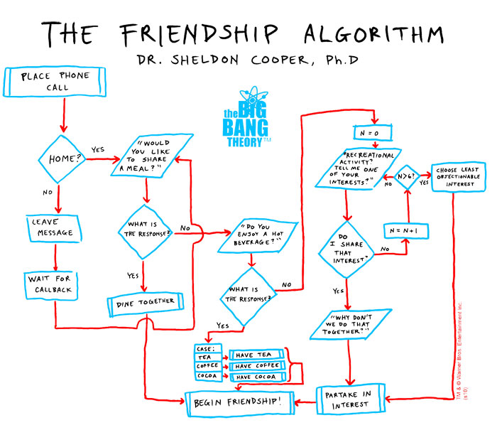

Slide 46
Deterministic Turing Machine
Halting Problem
In 1930’s, Alan Turing, founder of modern computer science has proved that there does not exist any Turing machine that, given a turing machine and an input, can determine if the turing machine will finish with the input.
Non-Deterministic Turing Machine
Decision
State
Are you
Sure?
Yes
No
No
Yes

Slide 47
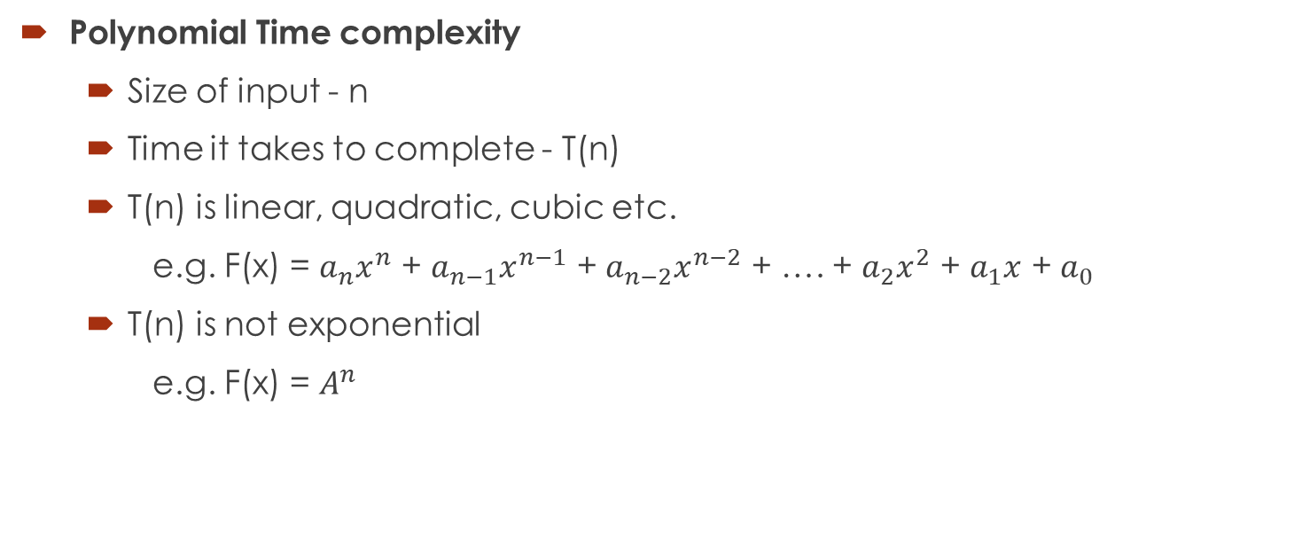
Polynomial Time complexity
Size of input - n
Time it takes to complete - T(n)
T(n) is linear, quadratic, cubic etc.
e.g. F(x) = $a_{n}x^{n}$ + $a_{n−1}x^{n−1}$ + $a_{n−2}x^{n−2}$ + …. + $a_{2}x^{2}$ + $a_{1}x$ + $a_{0}$
T(n) is not exponential
e.g. F(x) = $A^{n}$

Slide 48
Class P and NP:
P problems:
set of problems that can be solved by a Deterministic Turing Machine in Polynomial time.
All algorithms computer can solve
e.g. Merge sort, Addition of 2 numbers
NP
P

Slide 49
NP problems:
Set of decision problems that can be solved by a Non Deterministic Turing Machine in Polynomial time
NP is set of decision problems which can be solved by a polynomial time via a "Lucky Algorithm", a magical algorithm that always makes a right guess among the given set of choices
e.g. Solving Sudoku
P is subset of NP
Verifiable on Deterministic Turing Machine

Slide 50
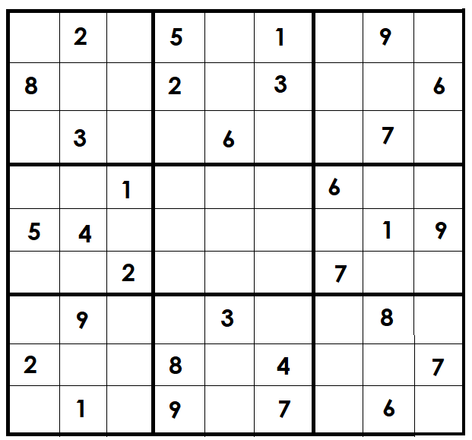
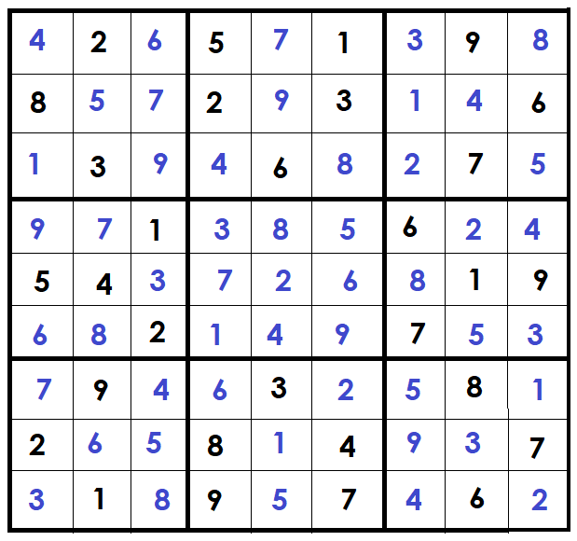
Class P and NP
Solving and Verifying problem
e.g. Sudoku
Solve this
Verify this

Slide 51
Polynomial Reduction:
Let L1 and L2 be two decision problems.
Suppose algorithm A2 solves L2. That is, if y is an input for L2 then algorithm A2 will answer Yes or No depending upon whether y belongs to L2 or not.
The idea is to find a transformation from L1 to L2 so that the algorithm A2 can be part of an algorithm A1 to solve L1.
In short - Reduce a new unsolved problem to already solved problem.
Algorithm for L1
X
Transform f
F(x)
Algorithm for L2
Yes/No
Yes/No
Input
for L1
Input
for L2
answer
for L2
on f(x)
answer
for L1
on x

Slide 52
NP-Completeness and NP-Hard:
NP-Complete problem
Hardest problem in N set
A decision problem L is NP-Complete if,
L is in NP (Any given solution for NP-complete problems can be verified quickly but there is no efficient known solution)
Every other problem in NP is reducible to L in polynomial time
If we can solve this problem in Polynomial time than we can solve any NP problem in Polynomial time
e.g. Vertex Cover Problem, SAT (Boolean Satisfiability Problem), Travelling Salesman Problem

Slide 53
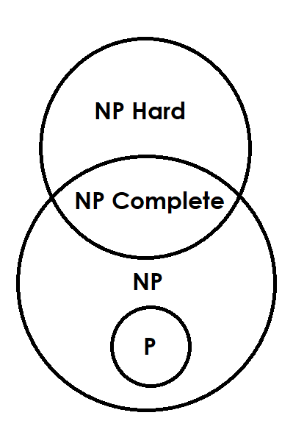
NP-Hard Problem
follows property 2 mentioned above
Doesn't need to follow property 1.
e.g. Turing Halting Problem

Slide 54
Travelling Salesman Problem
The travelling salesman problem consists of a salesman an a set of cities.
The salesman has to visit each one of the cities starting from a certain one (e.g. the hometown) and returning to the same city.
The challenge of the problem is that the travelling salesman wants to minimize the total length of the trip.

Slide 55
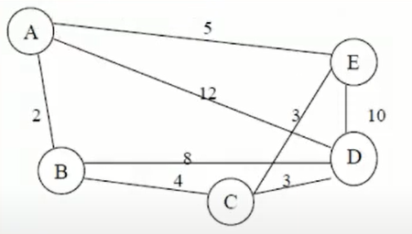
Travelling Salesman Problem
The problem lies in finding a minimum path passing from all vertices once.
For example the path
Parth1 {A, B, C, D, E, A}
Total weight - 24
Parth2 {A, B, C, E, D, A}
Total weight - 31
NP-Complete problem

Slide 56
Conclusion:
P | NP | NP Complete | NP Hard
Solved in Polynomial Time on Deterministic Machine | Solved in Polynomial Time on Non-Deterministic Machine | Problem R is NP-Complete if - R is NP and - Every NP problem P is reduced to R | A problem that is NP-Hard is at least as hard as Hardest problem in NP
Verified in Polynomial Time on Deterministic Machine | Verified in Polynomial Time on Deterministic Machine | If we can solve this problem in Polynomial time than we can solve any NP problem in Polynomial time | All problems in NP are reduced in Polynomial time to problem X then X is NP Hard
 |  | Most Difficult NP Problem Ref. Universal Turing Machine | Not necessary to be in NP

